Slide 1
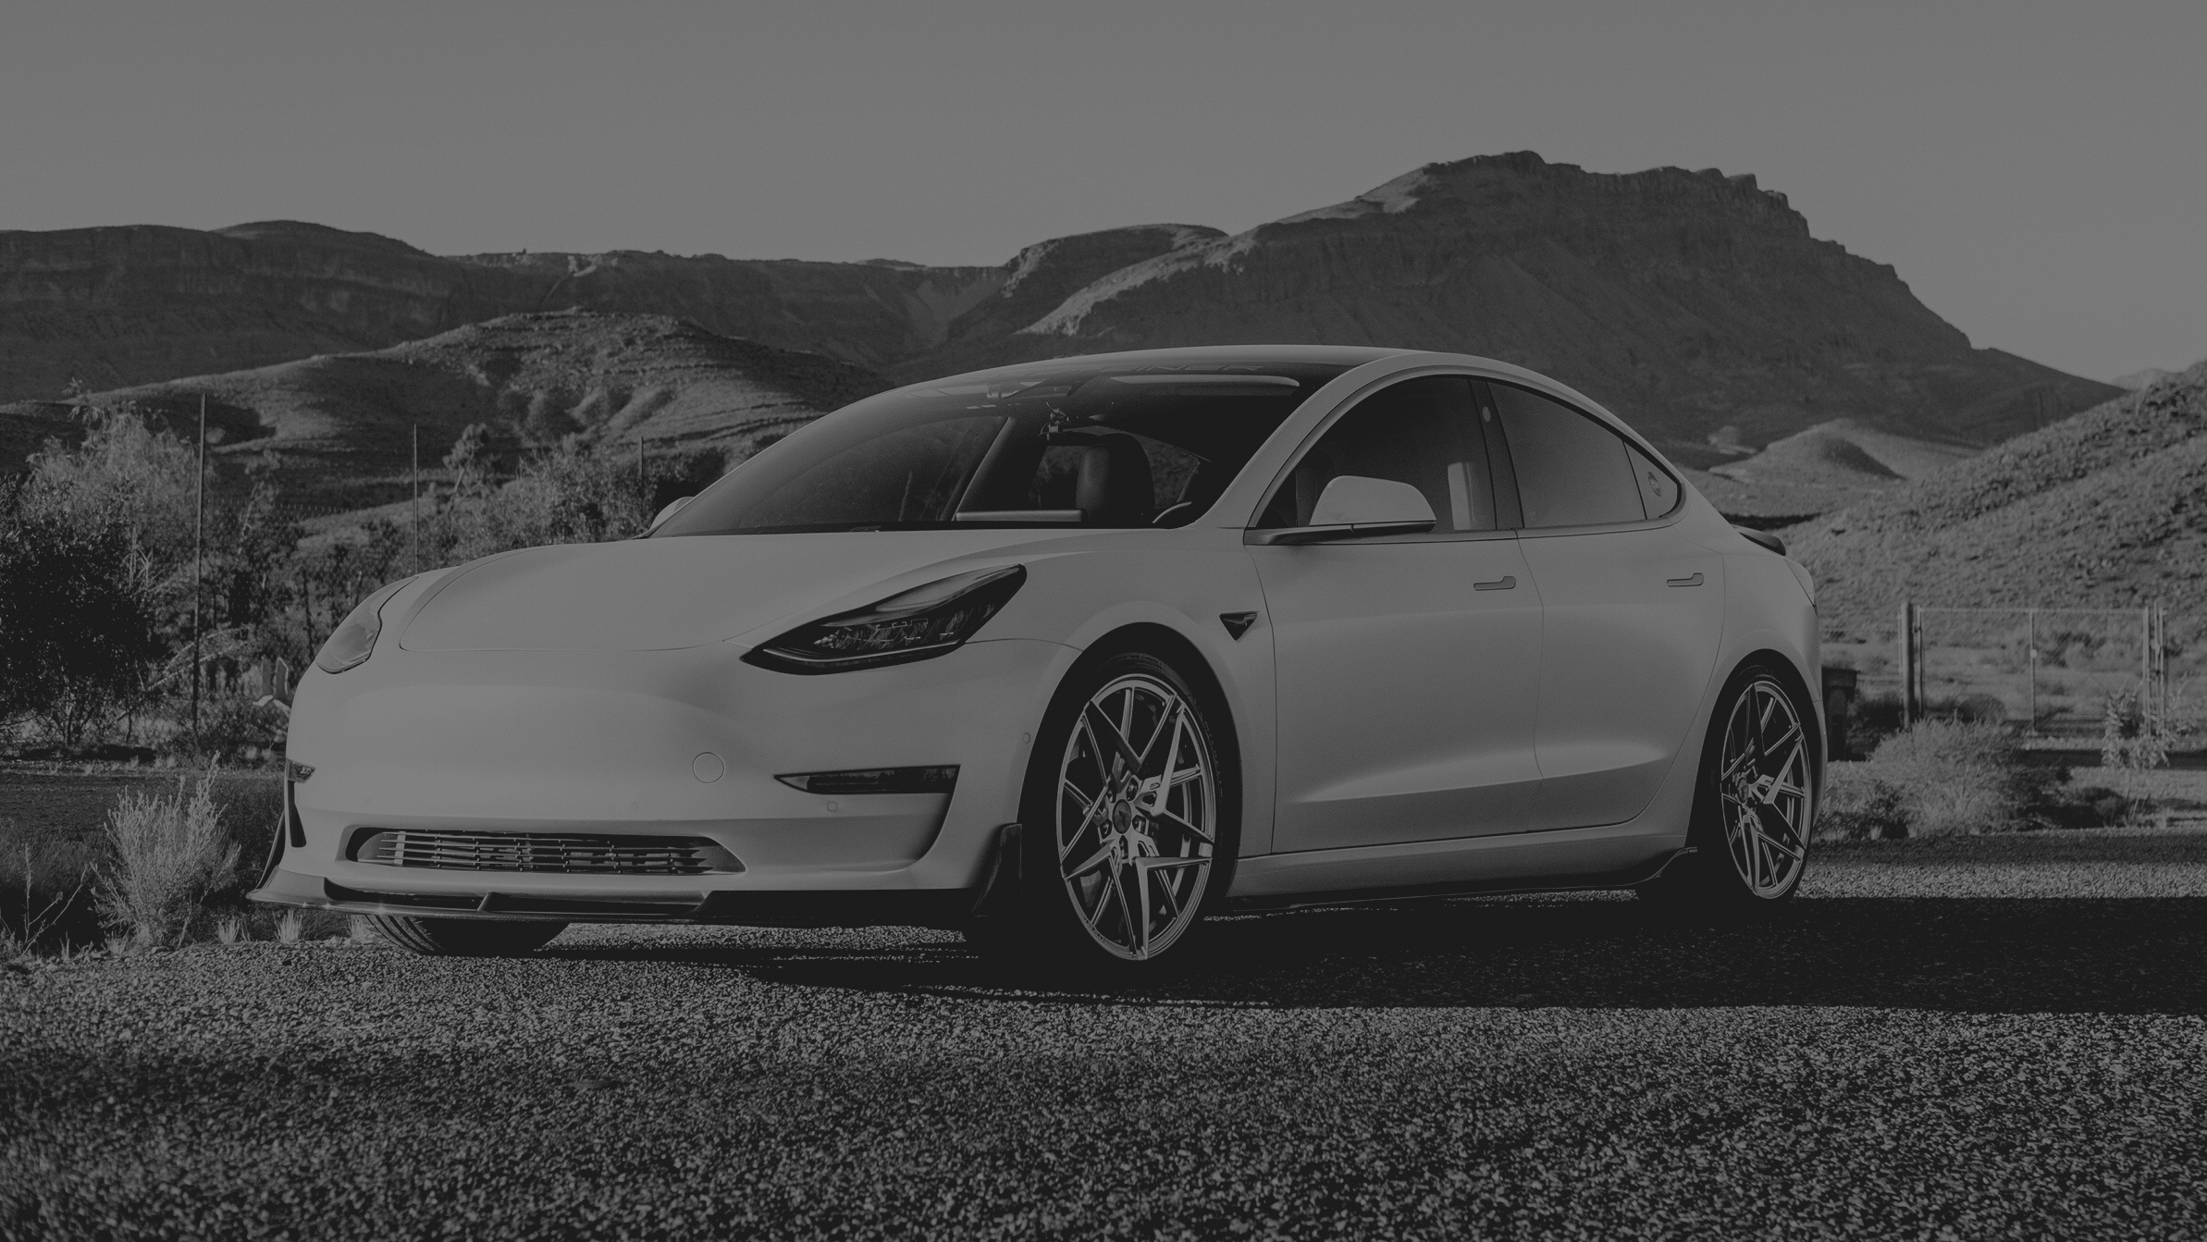
ROAD ACCIDENT RESOLUTION USING CONNECTED CAR TECH
EVERYTHING THAT CAN BE AUTOMATED
WILL BE AUTOMATED!

Slide 2
PROBLEM STATEMENT
Road accidents are one of the major reasons for fatalities in the world and with increase in population and the number of cars on road, the statistics of accidents are on a steep slope.
Every year around 20-50million people get involved in road accidents and around 1.3 million people die every year by getting involved in accidents that are fatal

Slide 3
ABSTRACT
The victim faces a lot of trouble such as financial trouble due to medical bills and absence at work due to the accident, car repairing charges to be paid since the insurance companies only covered a fraction of the cost involved in repairing due to lack of evidences from the accident.
Meanwhile, the culprit enjoys his/her time out of jail and tries his/her best to manipulate the evidences (if any) in his/her favor.
This is the usual aftermath of an accident in third war countries.

Slide 4


THE MAIN CAUSES OF ROAD ACCIDENTS :-
OVERSPEEDING
RASH DRIVING
ILL-MAINTAINED CAR
NOT FOLLOWING RULES SUCH AS JUMPING RED LIGHTS,NOT FOLLOWING LANES ETC

Slide 5
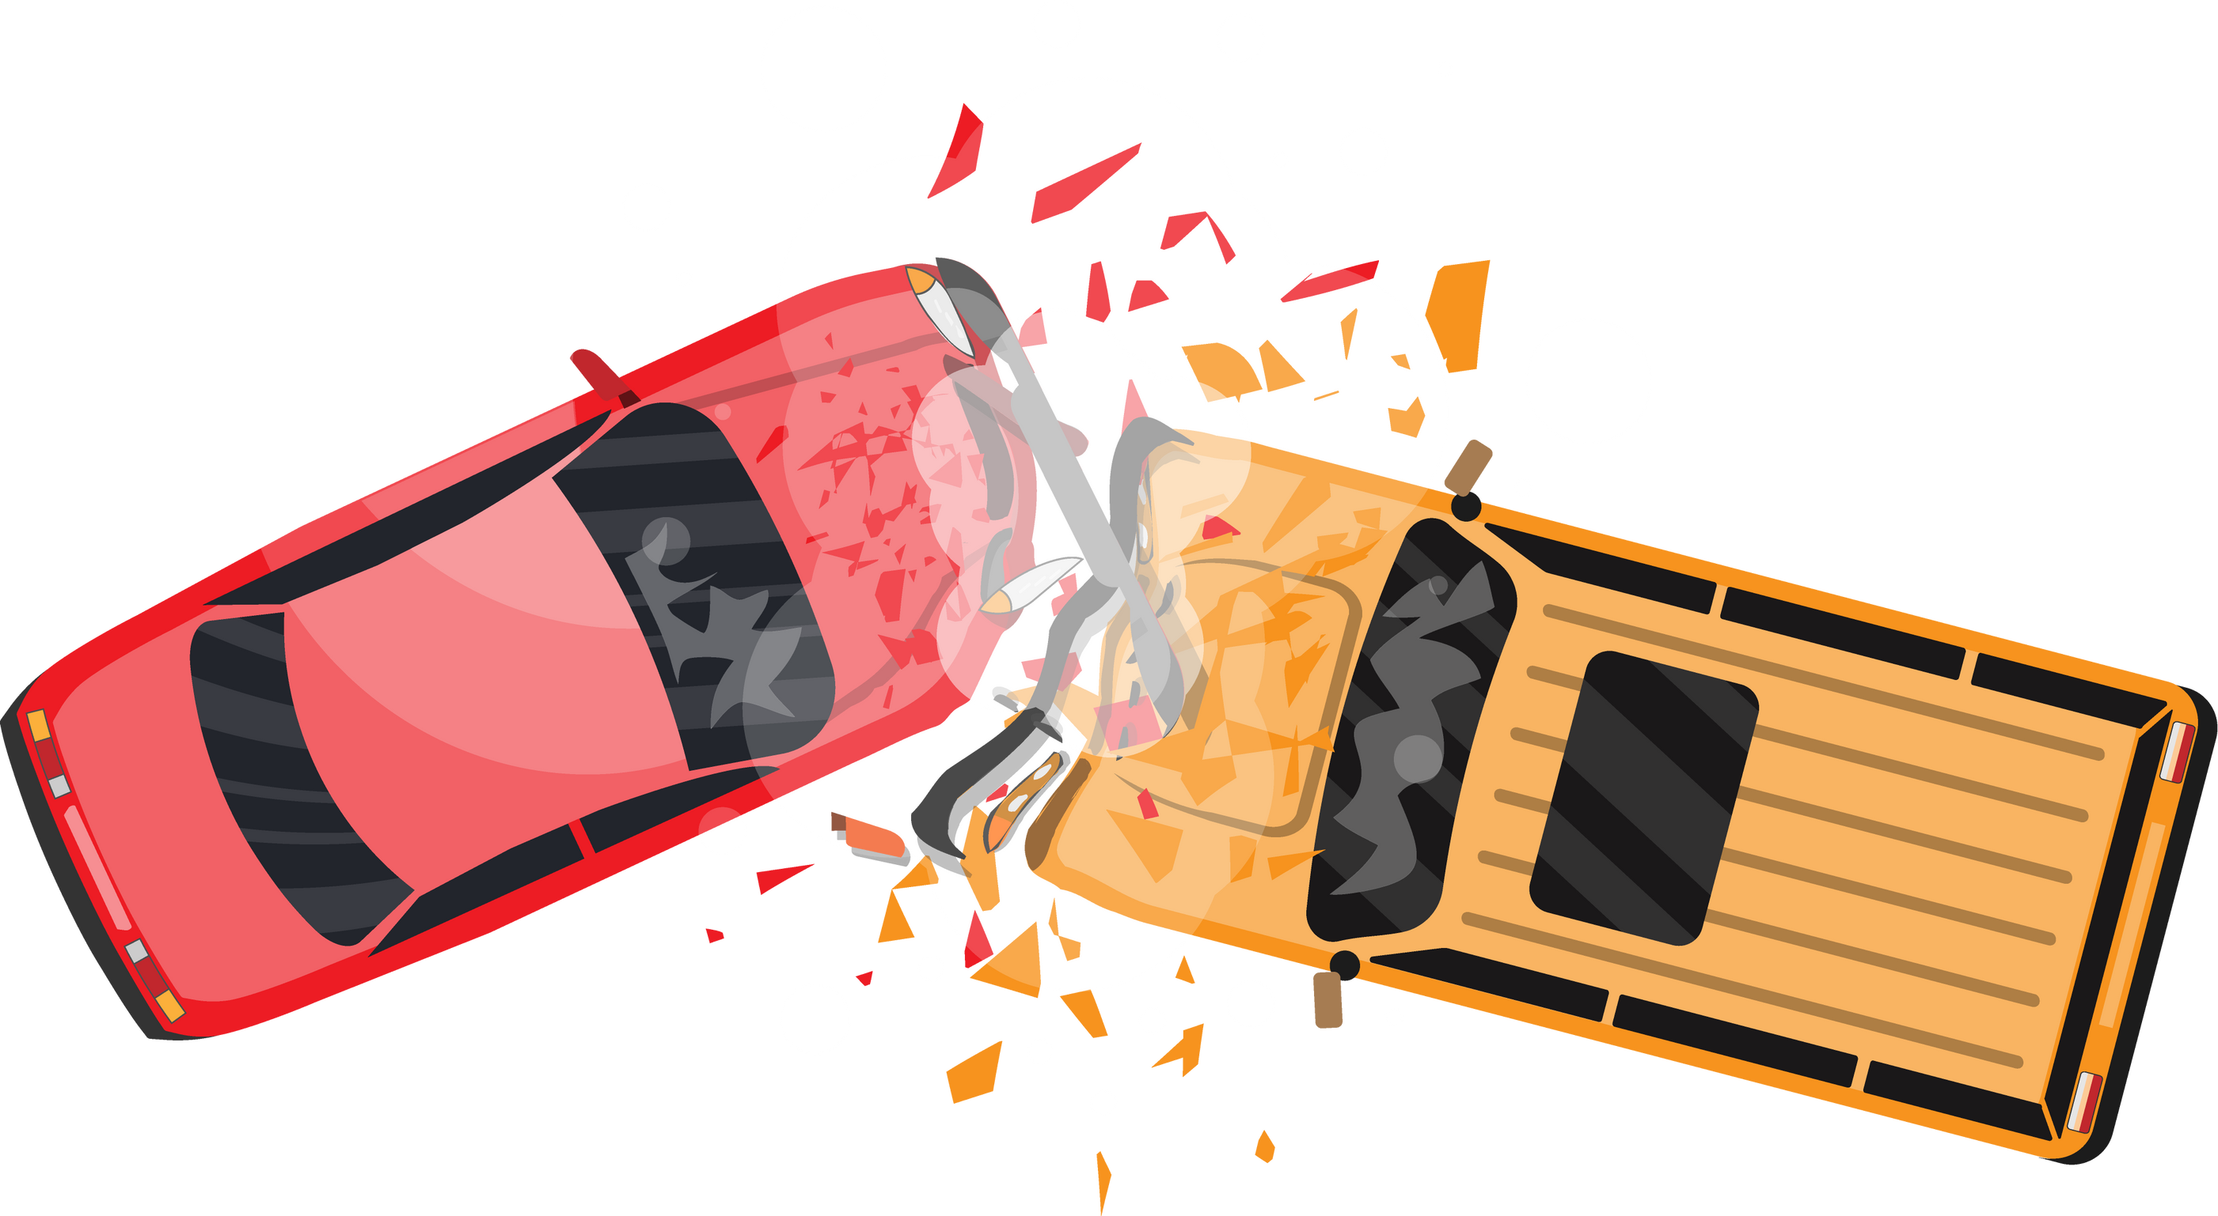

EXISTING RESOURCES TO CATCH THEM :-
CCTV CAMERAS
PETROLING CARS
SPEED CAMERAS/RADARS
DASHBOARD CAMERA INTEGRATION BY FLEET OPERATORS

Slide 6

SOME DISADVANTAGES OF PRE EXISTING SOLUTIONS
Privacy Concerns as it records you entire time as well as it can cause a privacy breach to other 3rd party people on the road who are not involved with the crash in any way.
It can only produce video evidence and can not provide any other details such as driver inputs, speed metrics, etc.
It can only produce video evidence and can not provide any other details such as driver inputs, speed metrics, etc.
It can only produce video evidence and can not provide any other details such as driver inputs, speed metrics, etc.

Slide 7

NOVELTY
We are proposing a unique and Novel idea of standardizing the use of physical OBD port reading devices and using the data metrics provided by them to recreate a visual representation of what exactly happend during the accident by using the data taken from the OBD port of driver's inputs before the accident & using machine learning and AI algorithms along with this data to recreate a 3D visual/graphical video format, which can be taken into account while resolution of accidents in courts.

Slide 8
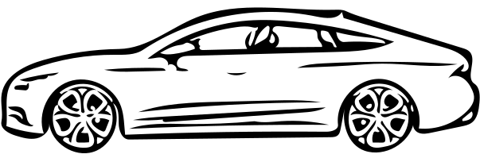
OBD PORTS
To come up with these constraints of using camera based resolution systems, we can develop a system which can make use of existing technologies and BY INTRODUCING A PHYSICAL DEVICE KNOWN AS AN OBD READER .

Slide 9
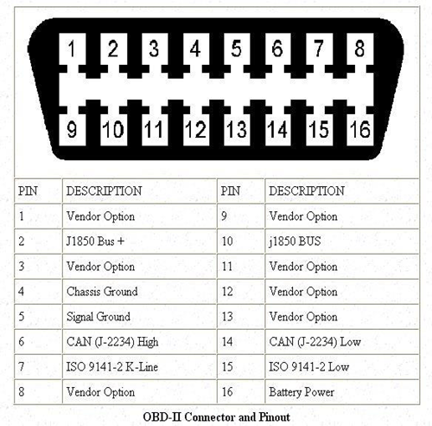
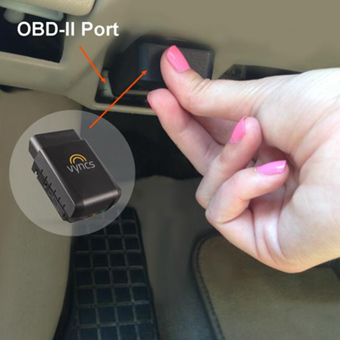
OBD PORTS

Slide 10
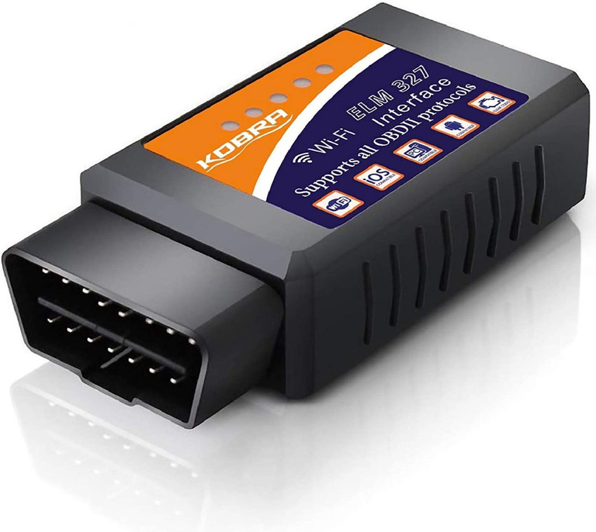
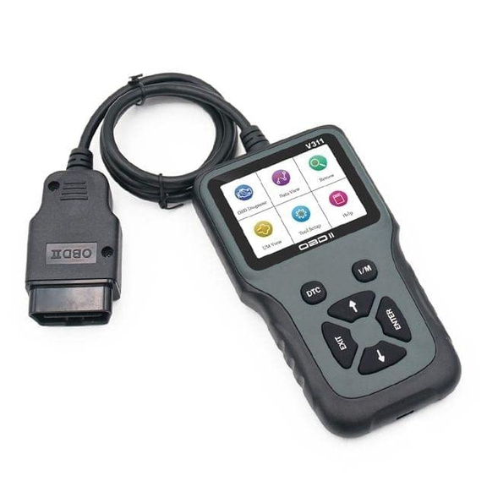
ENABLING TECHNOLOGY
1. The OBD-II port/Reader
An OBD reader (also called a diagnostic scanner or scan tool) is a vehicle diagnostic device that can be used to read the error memory and data that is recorded on your vehicle systems.

Slide 11
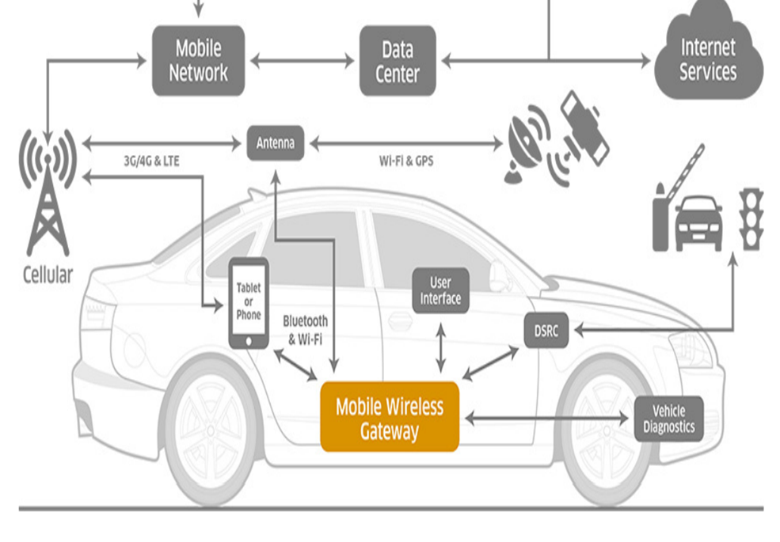
ENABLING TECHNOLOGY
2. Internet of Things [IoT]
The term “Connected Cars” has been made possible due to the arrival of this technology. IoT refers to the system over which devices can connect with other smart systems on the same network.

Slide 12
ENABLING TECHNOLOGY
3. Embedded e-sim
With the adoption of connected car tech in the automotive industry, manufacturers are providing electronic sim cards in almost every cars which enables the car to be connected to the internet.These electronic sim cards enable the car’s crucial sensors and systems to be connected with each other on the same network making it possible for these sensors/systems to exchange information and provides internetaccess to the peripheral devices

Slide 13
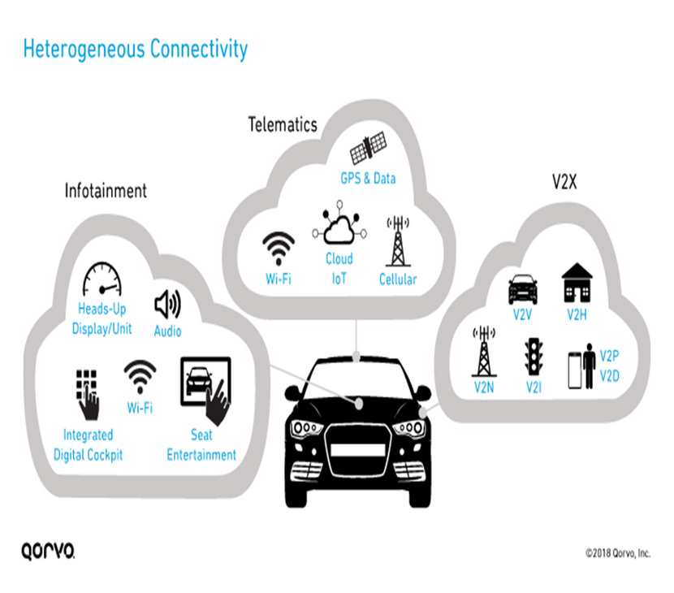
ENABLING TECHNOLOGY
4. Cloud Computing
-Delivering computing services such as servers, databases, networking, software, analytics etc. over the internet is called Cloud Computing

Slide 14
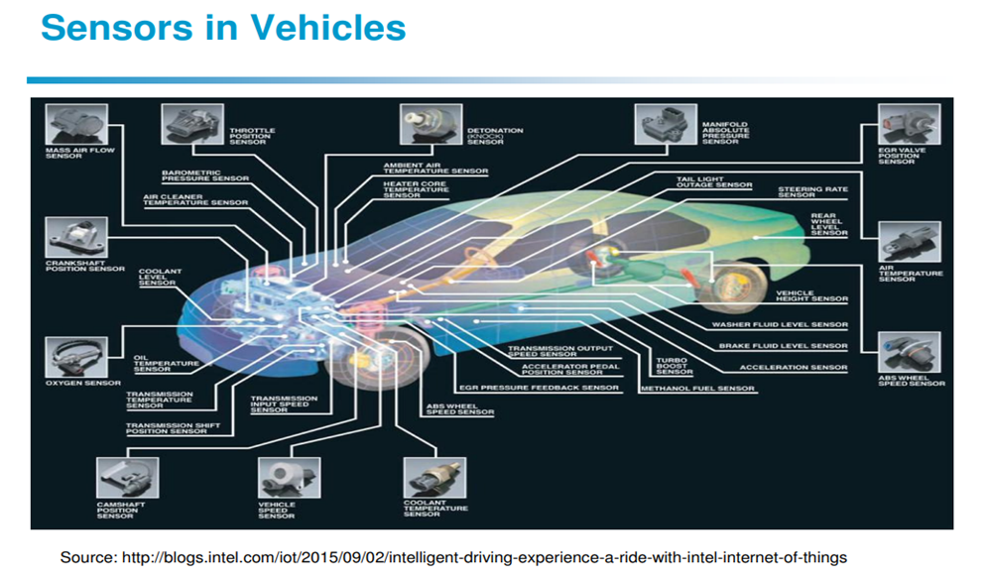
ENABLING TECHNOLOGY
5. Smart Sensors/Actuators
Automotive sensors can sense a lot more data, monitor various aspects of the vehicle and can send the information collected to the ECU.

Slide 15
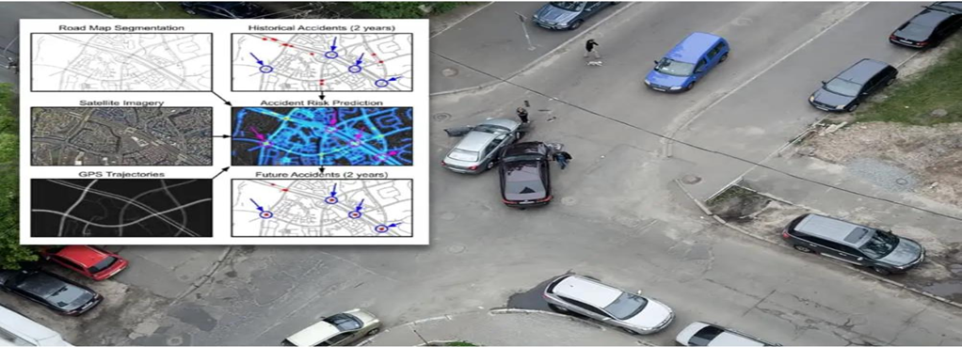
ENABLING TECHNOLOGY
6. Machine Learning
This technology enables the computer systems to learn and adapt to situations without the help of any pre-requisite set of instructions by using algorithms and statistical models

Slide 16
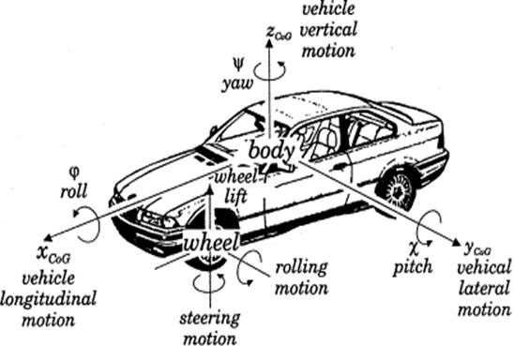
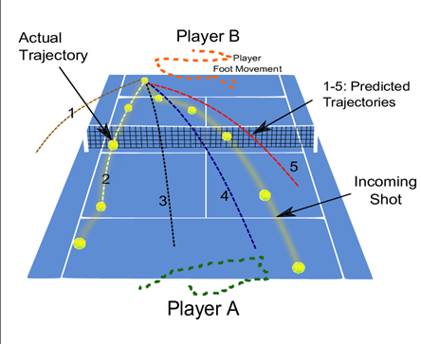
ENABLING TECHNOLOGY
7. Simulation Technologies
It is a computer based vision projection system which created a 3D visual projection of objects based on data received by multiple sensors

Slide 17
ENABLING TECHNOLOGY
8. Newer Generations of Mobile Networks
Every generation of mobile network that arrive opens a wide range of possibilities for enhanced connectivity of peripherals.With the help of these upcoming generations of mobile networks, communication between end to end devices and peripherals will be extremely fast as well as latency free that will make it possible for real time data exchange without any delay

Slide 18
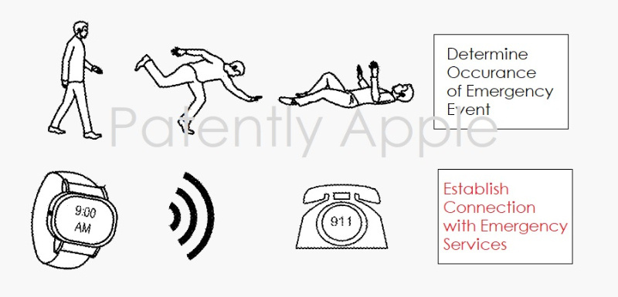
ENABLING TECHNOLOGY
9.EXISTING MOBILE/PORTABLE TECHNOLOGY
One such example is the smart watches that we are seeing today. These smart watches have so many sensors in them in such a compact design that can read and process all the data such as gyroscopic movements, distance travelled, path of movements, intensity of forces, fall detection and these devices can even detect an accident if you are wearing them in case of an accident

Slide 19

SYSTEM OVERVIEW
Imagine a world where this road accident resolution system exists and two cars A and B got involved in an accident. Both the drivers got out of their cars and seek medical attention (if needed). Then they go to their nearest police station and both the drivers report the accident along with the location, time and car’s registration number.
The designated accident resolution correspondent in the police station then punches the information on the government cloud portal in the designated computer system having internet access. Both the car’s past driving statistics comes to the screen and the correspondent notices and confirms that both the cars met into an accident at the exact particular time provided since both the cars gave impact information at the same Indian Standard Time

Slide 20
SYSTEM OVERVIEW
Both the cars were equipped with OBD ports, e-sim for connectivity and a standard OBD reader mandated by the government. These OBD readers had already collected both the driver’s past driving history and the instantaneous data right before the accident took place along with both the driver’s last inputs (acceleration, break and steering).
These data collected by the OBD port were read by the standard device and with the help of connected tech and internet inside the car due to the embedded e-sim , the data was uploaded in real time to the government’s cloud servers acting as a Blackbox in case of accidents
This data accumulated in the cloud is accessed by the designated computer in the police station using the car’s unique registration numbers. Now this data is automatically sent to a designated AI based website where with the help of machine learning and deep learning algorithms along with all the technologies mentioned above , data is transformed into useful 3D visual simulation

Slide 21

The advantages of this system proposed using existing technologies and existing OBD port execution over existing technologies such as use of CCTV and Dash-Cams are :-
This OBD SENSOR Technology implementation will be much cheaper and cost effective as compared to other methods.
There will be NO PRIVACY CONCERNS as there wont be any sort of video or personal information at risk. Simply the drivers input data , cars health and gps locations of the place of incident will be shared to the cloud which will not be a threat to privacy. As a result, other people’s privacy can also be taken care of since no means of video or graphical data will be shared to the cloud.
This will be a standard practice all over the country and will be mandatory in every car right from the factory just like ABS and airbags are .
Since it will be a standard practice, standard protocols for resolution will be followed as a result quick resolutions could be made and people will not have to go to courts anymore thus speeding up the process in a more efficient manner.

Slide 22

IMPLEMENTATION
The government of every country regulates rules and regulation to be followed by the automobiles of the respective countries. The governments make sure that with time, safety and developmental standards are met by making certain certifications such as Global NCAP certifications, Euro NCAP certifications, Euro emission levels etc.
If we talk specifically about India, in India we follow the emission and safety standard known as “Bharat Stage”. At the time of writing this research paper, India is following the Bharat Stage 6 level of emission and safety norm which includes stricter permissible emission norms .
Just like these emission norms keep on updating, the government time to time also focuses on updating the safety norms such as airbags, anti-lock braking systems(abs), day-light running lamps (drl) etc were made mandatory in vehicles.
Also since the cars are evolving at a much faster rate and the car manufacturers are providing connected tech along with e-sim technology being incorporated in almost every car as well, we can say that the government will soon be bringing changes in safety norms again making the safety rules even more strict.

Slide 23
IMPLEMENTATION
With time, the government can easily introduce new laws making “OBD readers” a mandatory equipment to come in cars straight out from the factory from the manufacturers end.
Along with this mandatory OBD reader, the government can also establish the cloud network required for this system to work. Gradually in few years, every car on road will have this proposed Road Accident Resolution System and the problems of accident resolution and its effects on people will be reduced drastically
This will help the government save millions if not billions in respective currencies as the court proceedings will be much quicker
Also , by saving a lot of manpower, the government can apply the police forces in several other important things. This proposed Road Accident Resolution System will not only help the government, but also the people making the world a better place to live in

Slide 24

The government every year spend hundreds if not thousands of crores on traffic enforcement police officiers and infrastructures to catch irregular drivers on the road constituting of majority of road accidents taking place.
--- can save crores of rupees on individual police personells
--- every area of road will be covered since speed cameras can not cover every inch of road and thus each and every inch of road will be safe from maniac drivers
--- people will fear as they know if they violate the rules, they will be in trouble.
--- in case of accidents, easy time efficient and accurate decisions can be made and the data recorded in clouds will act as blackbox for cars in case of any accidents.

Slide 25
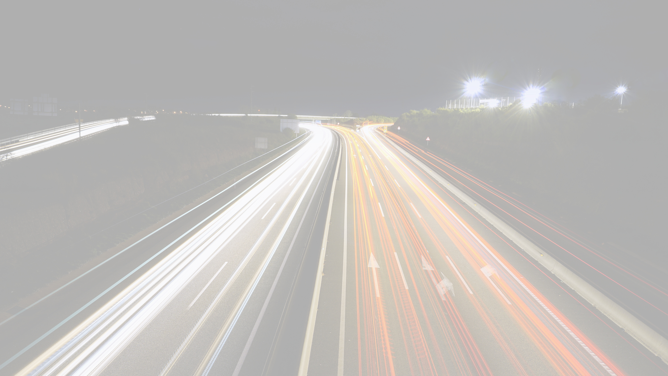
CONCLUSION
This project is focused on how to solve the problem of long queues in courts with respect to road accidental cases and focused on easing the process of accidental resolution using existing technologies resulting in extremely accurate and time efficient resolution.
The study also explored the disadvantages of using the current camera based resolution system that exists in many countries and proposed a better, safer and more reliable form of resolution by bringing existing technologies under one roof and integrating them together.

Slide 26

FUTURE WORKS
Apart from this accident redressal and efficient insurance claims, this technology can also be used to monitor rash driving/unsafe driving/irregular maintenance of cars/Over speeding and many other factors that can potentially become a cause for upcoming accidents.
The government can keep a track of unsafe drivers like this and can fine them remotely resulting in reduced loads on traffic police responsible for the same

Slide 27


Thank You
MADE BY :-
ATUL KIRTI-RA2011029010010
ANKITA DAS-RA2011029010023

